Slide 1
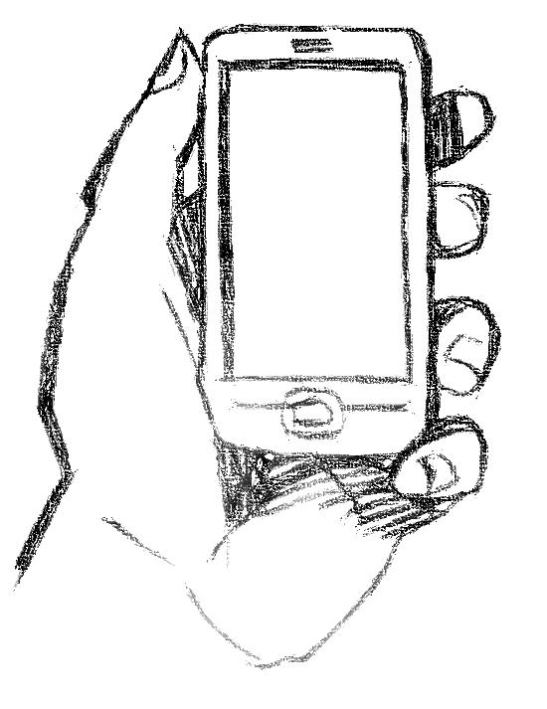
BRING YOUR OWN DEVICE
Presenter:
Rachelle R. Green
Duffy & Sweeney, Ltd.

Slide 2
OVERVIEW
Relatively new phenomena
Cell phones have been in workplaces for years, but huge increase in use of smart phones and tablets raise new issues re: safety, security, privacy, and wage and hour compliance
Issues and resolutions vary by company

Slide 3







A New Style of IT –
Data, Data Everywhere…
Mainframe
Client/Server
Internet
Mobile, Social, Big Data & the Cloud
Every 60 seconds:
698,445 Google searches
695,000 status updates
217 new mobile web users
98,000+ tweets
168 million+ emails sent
11 million instant messages
1,820 TB of data created

Slide 4
BYOD Adoption
What’s Driving BYOD Adoption?
Consumerization of IT
Increased Productivity
Appeal of consumer technology
Convenience for users
Increased accessibility
Recruiting tool
Reduced expenses
75% of surveyed organizations allow employee BYOD!
51% could bring any device, with little to no policy measures
Only 24% had any sort of compliance policy in place

Slide 5
BYOD Implementation Scenarios
Embrace
Contain
Disregard
Block
Embrace – Allow everyone to use all devices to access all resources
Contain – Allow some people to use some devices to access some resources
Disregard – Ignoring the presence of personally owned devices in a corporate environment
Block – Ban the use of consumer-grade products or services by explicitly prohibiting their use in an appropriate policy
High
Business Value
Low
Low
High
Gartner, “NAC Strategies for Supporting BYOD Environments,” December 2011, Lawrence Orans and John Pescatore
Security Pressure

Slide 6
What is Information Governance?
Gartner defines information governance as “the specification of decision rights and an accountability framework to encourage desirable behavior in the valuation, creation, storage, use, archival and deletion of information. It includes the processes, roles, standards and metrics that ensure the effective and efficient use of information in enabling an organization to achieve its goals”
http://www.gartner.com/it-glossary/information-governance

Slide 7

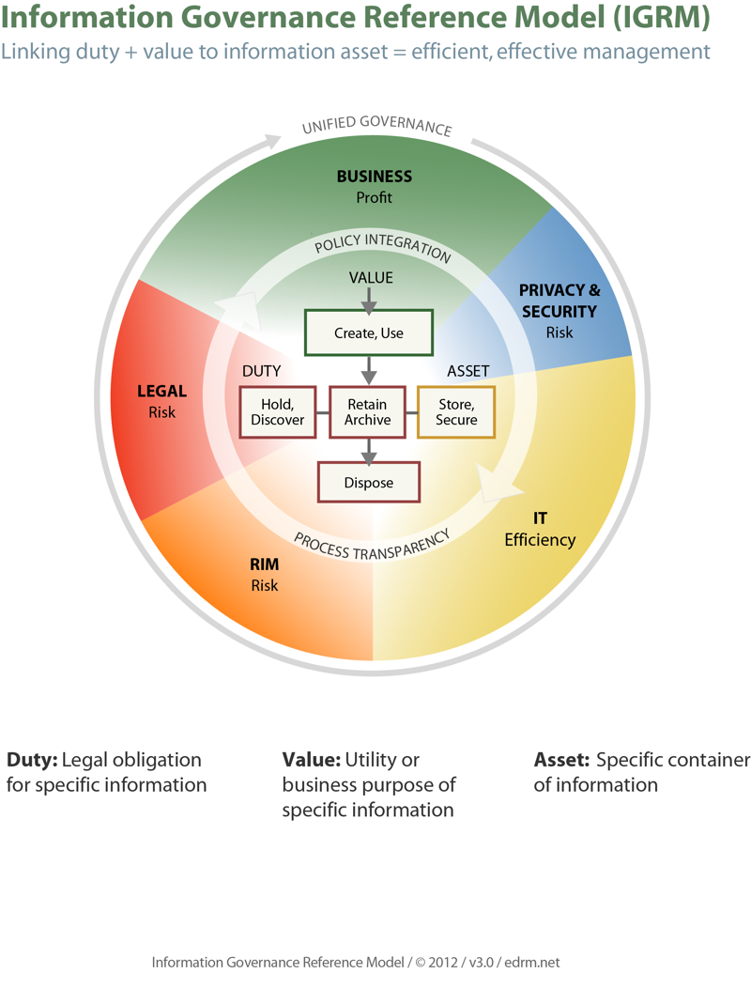
Increased Productivity & Accessibility
Cool factor/morale
Convenience/work-life
Physical & Cyber Security
Confidentiality
Privacy v. monitoring
Data flows/access
Mobile Device Management
NAC
Employment Issues
  Wage/Hour
  Expense Reimbursement
  Harassment
Global Trade/encryption
IT Infrastructure
Hardware savings
Bandwidth/Network
App selection/development
Records & Info Management
Legal Hold/Discovery
http://www.edrm.net/archives/13649

Slide 8

The Implementation Roadmap
Defining BYOD
The Scope of BYOD
Security Issue Spotting
Privacy Issue Spotting
Components of a BYOD program
BYOD Policy fundamentals

Slide 9
Security Issue Spotting
Managing Devices
Policies
Trainings
Enforcement

Slide 10
Privacy Issue Spotting
International Workforce
Access to Data
Retention
Litigation Hold and E-Discovery

Slide 11
Other Best Practices
Understand your mobile device population–Hypo
Make Enrollment Easy
Configure Devices Over-the-Air
Provide Self-Service
Designate Personal Information as Secure
Isolate Corporate from Personal Data
Continuously Monitor
Manage Data Usage
Consider how Policy Impact ROI

Slide 12
Additional Concerns
EEO and Harassment
Records Management and Data Collection
International Challenges
Wage & Hour Risks
Safety Concerns

Slide 13
QUESTIONS?

