Slide 1
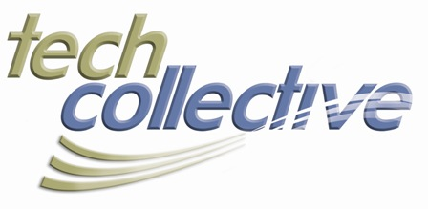
PATENT TROLLS
When The Hunters Become the Hunted
John L. Capone, Esq.
About The LEGAL TECH 2013 Series
It’s a regulated world out there, especially at the intersection of IT and the law. Don’t go it alone. This series of breakfast seminars sponsored with the law firm of Duffy & Sweeney and designed to address the most compelling legal issues that impact technology. Moderated by Chuck Schmidt, a partner in the IP and technology law practice, the seminars will offer big-picture insight and best-practices as well as answers to your specific questions.

Slide 2
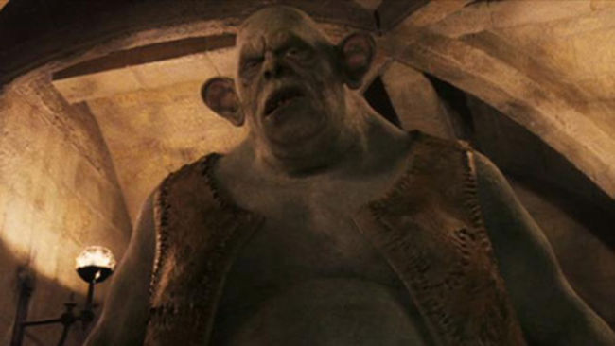

Slide 3
OVERVIEW
Patents 101
Enter the Troll
The Hunt Begins
Arming Yourselves
Whither the Troll

Slide 4
PATENTS 101
What is a Patent?
Traditional Purposes/Benefits
“When Bad Things Happen to Good Patents”
“Patent Trolls” Defined

Slide 5
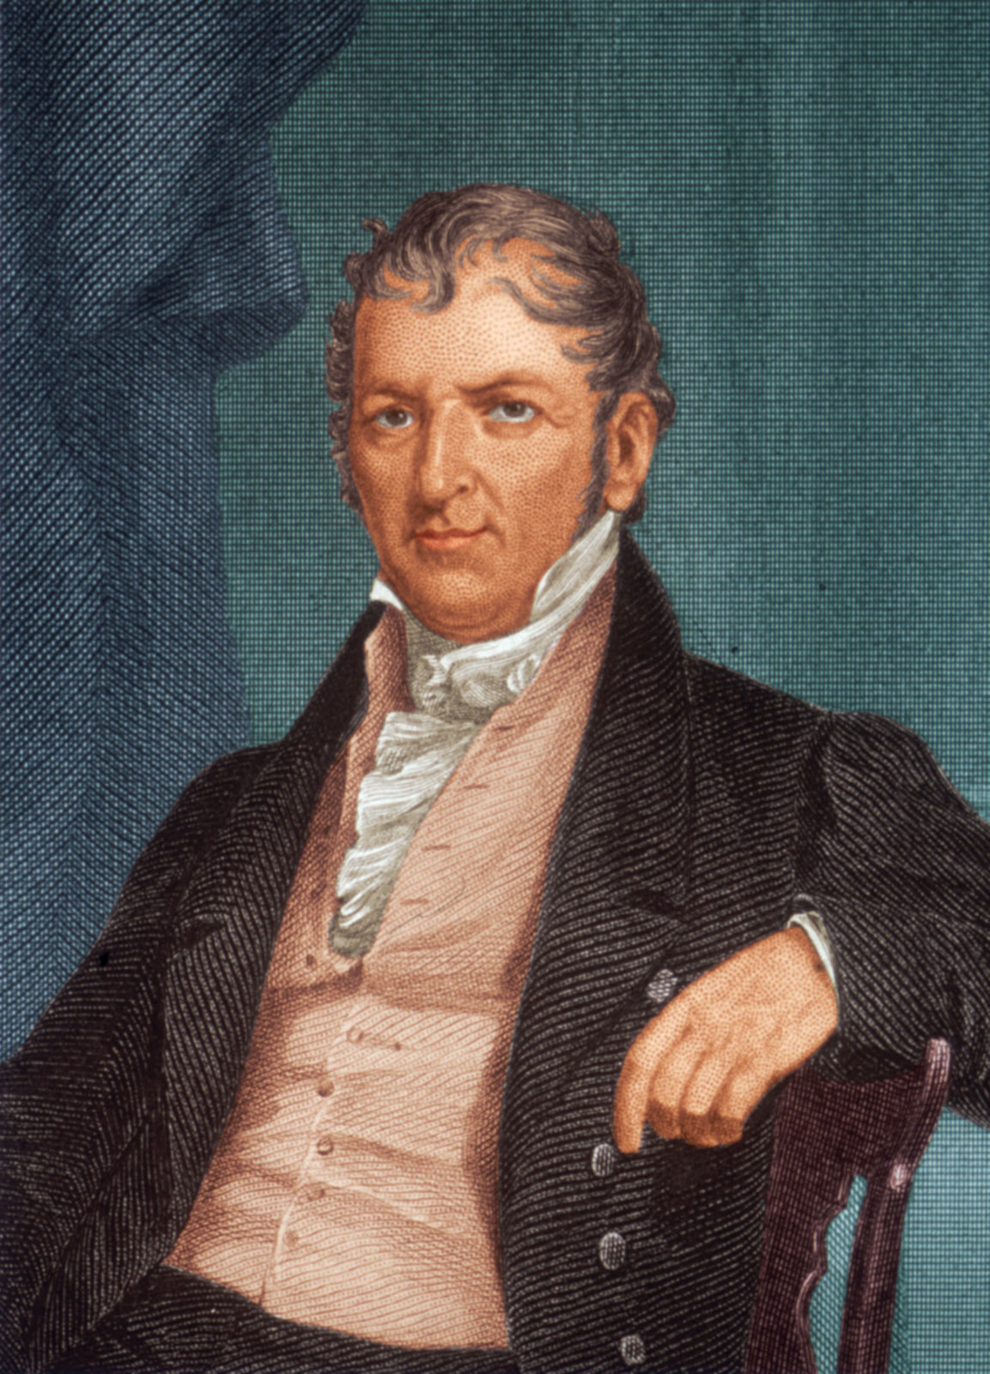
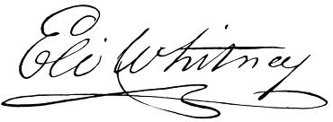
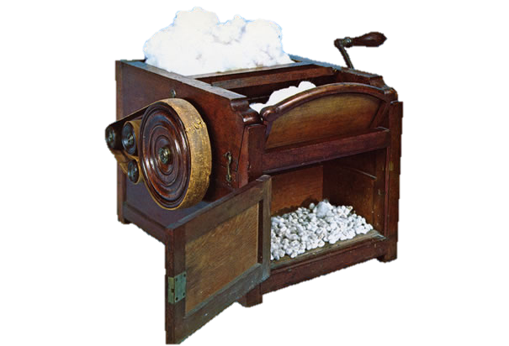

Slide 6
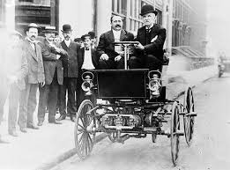
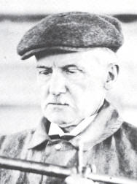
George B. Seldon

Slide 7
ENTER THE TROLL
Cost to defend a patent suit = ~ $1M pre-trial and $2.5M through trial.
PAEs initiated ~800 lawsuits nationwide (median revenue < $100M).
U.S. Businesses incurred $29B in direct costs due to patent trolls.
In 2012, PAEs initiated over 60% of all patent litigation matters (~2900; median revenue ~$10M) and represented over 59% of all defendants in ITC proceedings.
2004
2006
2011
2012

Slide 8
THE HUNT BEGINS
AIA
Courts
State Activism
Federal Legislation

Slide 9
AIA - America Invents Act
One suit, one infringer
Third-Party Submissions
Inter Partes Disputes

Slide 10
COURTS
U.S. Supreme Court - grants review of 2 cases troll-related cases:
Icon Health & Fitness, Inc. v. Octane Fitness, LLC
Highmark, Inc. v. Allcare Health Management Sys., Inc.
Federal Circuit Court of Appeals - Eon-Net LP v. Flagstar Bancorp
Confirms $600K sanction against Eon-Net for filing an “objectively baseless infringement action” in bad faith.
Actions tantamount to extortion where nearly identical complaints filed against many defendants and followed by “nuisance value” settlement demand letters.

Slide 11
STATE ACTIVISM
Vermont AG
Vermont Legislation
Minnesota
Nebraska

Slide 12
FEDERAL LEGISLATION
The Innovation Act - key provisions include a variety of previously proposed amendments to the U. S. Patent Act:
Real Party-in-Interest*
Discovery*
Joinder*
Customer Suits
Pleadings*
Attorneys’ Fees*
Covered Business Methods

Slide 13
ARMING YOURSELVES
How can it happen?
What do you do?
What are the alternatives?
What are the costs?

Slide 14
MITIGATING THE RISK
Awareness
Diligence
Pro-activity
Engagement

Slide 15
WHITHER THE TROLL
Wrap-up
One More Personification
Questions

Slide 17
“There are some things you can't share without ending up liking each other, and knocking out a twelve-foot mountain troll is one of them.”
― J.K. Rowling, Harry Potter and the Sorcerer's Stone

