Slide 1


2018 Wannamoisett Forum
Professional insight and championship golf for a select group of business leaders
May 29, 2018

Slide 2

Table of Contents
LOOK-BACK TO 2017
2018 OUTLOOK AND M&A TRENDS
CONSIDERATIONS BEFORE A SALE
PREPARING FOR A DEAL

Slide 3

LOOK-BACK TO 2017
Much like 2016, 2017 had a slightly lower volume of deals, but high performing companies that exceeded competition saw increased valuations.
Median valuation/EBITDA multiples increased for a third consecutive year to 10.4x.
Middle-market companies were targets in $100 billion in announced deals in 2017. That represents a 24 percent increase from the levels seen in 2016 and marks the highest aggregate value for middle-market deals since 2014
Leveraged buy-out (private equity funds) activity in the middle-market space rose to $8.9 billion in 2017 from $6.7 billion a year earlier.
Median deal size for PE deals spiked to $197.2mm in 2017 from $128.6 in 2016.
IT and tech fields have shown a steady increase in both deal volume and valuation over the past few years.
As deal count decreases, deal add-ons have become more popular, especially with PE
buyers

Slide 4
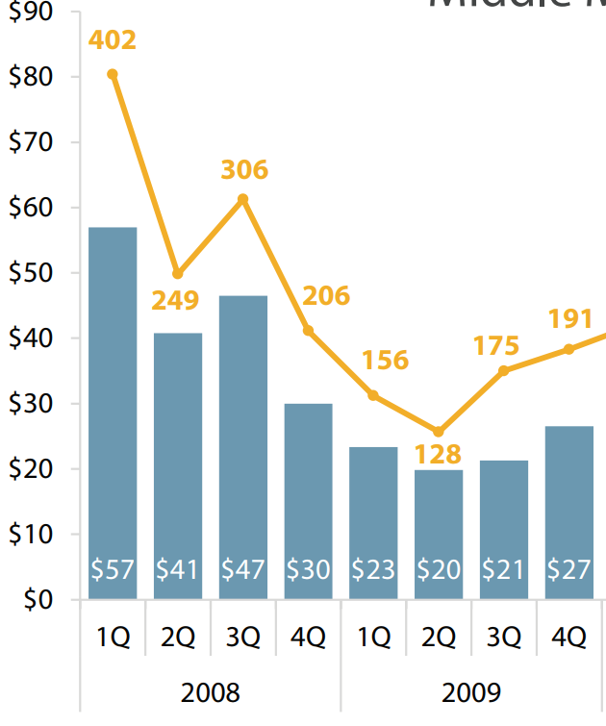
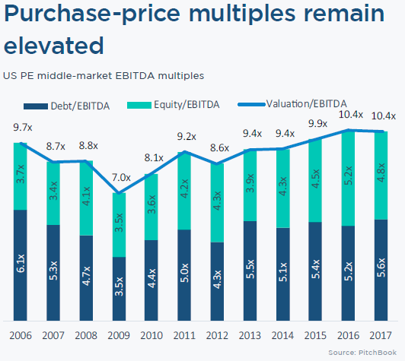
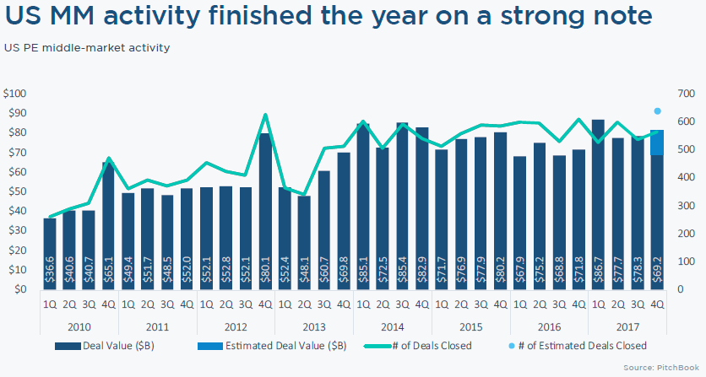
LOOK-BACK TO 2017
2006-07 marked a relative high point for both deal flow and deal value. 2008 saw the collapse of Lehman Brothers in Q3 and its effect on the market.
M&A markets have rebounded following the Great Recession, and continue to rise.

Slide 5

2018 Outlook and trends
2018 OUTLOOK AND TAX CUTS AND JOBS ACT
PRIVATE EQUITY “DRY POWDER”
THINGS TO CONSIDER BEFORE A SALE:
  Timing The Market
  Baby-Boomer Owned Businesses
  RETIREMENT AND FAMILY PLANNING

Slide 6
Forecasting 2018
2018 Outlook and Tax Cuts and Jobs Act
Middle-Market Companies have outperformed expectations through Q1 2018:
  Revenue Growth reached 8.4%, well above the average over the past 6 years (6.7%).
  Employment Growth is at 6.3%, which is also well above the average of the past 6 years (4.0%).
Ernst & Young conducted a survey of 500+ executives of companies with over $500 million in annual revenues and found that “73% plan to ‘accelerate’ deal making strategies” in 2018.
Tax Cuts and Jobs Act (“TCJA”) passed in December of 2017
  Designed to stimulate the economy and create jobs
  TCJA reduced capital gains rates to 21% and lowered overall tax rates.
  Large corporate buyers will receive a windfall of extra cash from the corporate tax rate falling to 21% from 35%.
US firms are expected have an additional $300 to $400 billion in cash which could be used, among other things, on capital expenditures and acquisitions. (Pitchbook)
Market volatility in early 2018 raises some questions about large public company deals - typically involving stock as currency. Lower-middle-market private companies are not directly impacted by such swings and private buyers are still well-positioned to invest
Buyers AND Sellers agree that 2018 looks like another strong Seller’s Market

Slide 7
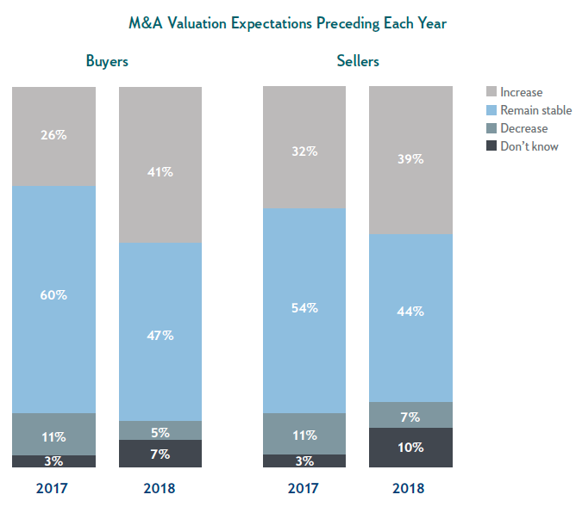
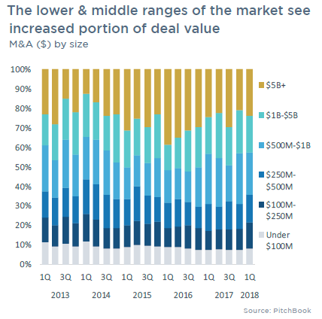
2018 Expectations and Early Returns
Forecasting 2018
Source: Citizens Bank

Slide 8




GOALS & OBJECTIVES
IS NOW THE RIGHT TIME TO SELL?
POSITIVE
NEGATIVE
Lower Buyer RoE expectations has expanded multiples.
Private equity sponsors have record amounts of capital to invest (a/k/a “dry powder”) and strategic buyers have record cash on their balance sheets.
Financial institutions and “non-bank lenders” have capital that needs to earn returns; debt for good deals is still competitively priced and widely available.
Financial covenants are still flexible for permissible leverage (4x1 in mid-market deals) but starting to tighten.
Based on the above – the mid-market “window” although starting to cool off at higher mid-market, is still open in terms of value from 2015 through Q1 2018.
According to Forbes, and other leading sources, a majority of small businesses, most of which are Baby Boomer-owned, will attempt a sale (as opposed to family succession) during the next 10 years.
Consider purchase price multiples, succession planning, health and family well-being, philanthropy and tax planning
INTERNAL FACTORS
STRENGTHS
WEAKNESSES
S
W
O
T
EXTERNAL FACTORS
OPPORTUNITIES
THREATS

Slide 9

PREPARING
FOR THE DEAL
CHOOSING A DEAL TEAM
M&A TIMELINE
DEAL STRUCTURE
DUE DILIGENCE

Slide 10
You have built a great business, but have you sold a business?
PREPARING FOR THE DEAL
CHOOSING A DEAL TEAM
Preparation should begin as much as 18 months prior to actual deal opening to maximize your valuation, minimize delay and ensure a successful outcome.
  Assemble the key internal management team to assess – valuation, expectation, market, future succession, key employee retention and prepare information for the sale process.
  Assess how an asset can best be packaged for sale – estate and wealth management planning
  Identify potential risk issues/trouble spots that may need attention
  Complete internal due diligence, sell-side Q of E, audits, set up data rooms, etc. – time is critical
  Prepare to communicate to the larger team that the company is preparing for a transaction

Slide 11


PREPARING FOR THE DEAL
M&A TIMELINE
PHASE I: MARKETING PROCESS
CONFIRMATORY DUE DILIGENCE AND CLOSING
Contact potential buyers
Respond to buyer questions
Distribute bid instruction letter
Finalize management presentation
Invite parties to presentation, begins when IB is chosen a/k/a “Dog and Pony Show”
Finalize due diligence and close transaction
Perform confirmatory due diligence
Negotiate transaction documents
Close Transaction
4 WEEKS
5 WEEKS
2 WEEKS
10-12 WEEKS/TOTAL 26-28 WEEKS
PREPARATION AND DUE DILIGENCE
PHASE II: PRESENTATIONS AND DILIGENCE
RECEIVE AND NEGOTIATE FINAL PROPOSALS
IB develops understanding of Company
Management Meeting
Due diligence and financial analysis
Teaser/confidential informational memo “CIM” created by IB
Confidentiality Agreement
PURPOSE
Evaluation and commencement of due diligence
DILIGENCE
Data room work
Management visit
DELIVERABLES
Purchase Agreement
Mark-Up/Terms
Choose buyer
Negotiate letter of intent including key purchase agreement terms
Sign definitive proposal

Slide 12

PREPARING FOR THE DEAL
UNDERSTANDING THE DEAL
Typical Methodologies for Mid-market Private Companies
OTHER KEY VALUE FACTORS TO NEGOTIATE
Majority of mid-market buyers use enterprise/equity valuation methodology - Multiple of TTM Adjusted EBITDA = Enterprise value less debt plus excess cash = Equity value
Discounted Cash Flow, for high growth where TTM does not value notable rapid ramp up
Other valuation methods – weighted comps, PE arbitrage
“Adjusted EBITDA” - GAAP earnings before interest, taxes, depreciation, and amortization revised to exclude the effects of nonrecurring items of revenue or gain and expense or loss including excess owner compensation and benefits
Free Cash Flow = operating cash flow minus maintenance capital expenditures – considered where CAPEX does not equal annual depreciation
Net Working Capital – e.g. prepaids, deposits, and setting the peg – seeing many issues here – clarify at LOI
Liabilities – e.g. pending litigation, pensions
Deal Structure – impacts peg for buyer and seller - e.g. capital gains or ordinary income – step up in basis heavily negotiated
Leverage drives returns, drives multiples up or down.
Same business can be worth significantly more in one year vs. another
Real Estate considerations

Slide 13
PREPARING FOR THE DEAL
KEY POINTS IN EVERY DEAL
Deal Structure
Stock/Equity vs. Asset Sale
Tax Analysis (net after tax proceeds)
Valuation/method?
Purchase price paid at closing vs. earn out or required PE/financial buyer “rollover equity”
GAAP or not GAAP - need to be consistent with past practices
Reconcile seller to buyer to avoid disputes post-closing
Examples:
  NWC
  Revenue redemption
  Inventory reserves
Indebtedness and financial reps - no projections and beware the word “prospects” and “prospective” ....
IP rep – “knowledge battle”
Indemnity Package
  Cap/Deductible
  Time limit
  Deductible
  Escrow
  Pro-seller vs. pro-buyer
  Rep and Warranty Insurance – Game Changer

Slide 14
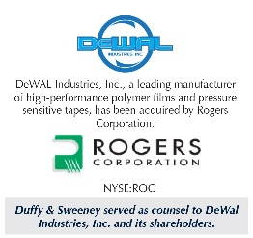



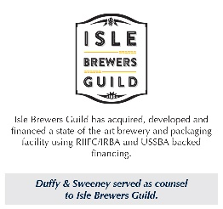










SELECT
TRANSACTIONS
(For a list of additional transactions visit www.duffysweeney.com)
M&A Outlook Blog –https://duffysweeney.com/business-owners-with-exit-dreams-may-leverage-middle-market-momentum/

