Slide 1
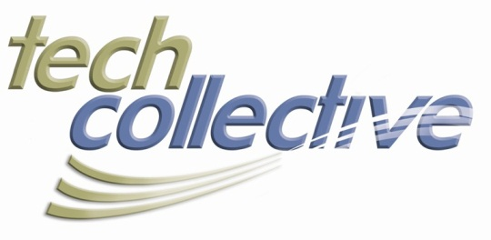
LEGAL TECH 2013 Seminar Series
BioTech and IP:
Protecting A Valuable Asset
Presenter:
Byron L. McMasters
DUFFY & SWEENEY, LTD
1800 Financial Plaza
Providence, RI 02903
(401) 455-0700
bmcmasters@duffysweeney.com
www.duffysweeney.com
@byronmcmasters
Tech Collective
3 Davol Square | Suite A330 Providence, RI 02903
401.521.7805
www.tech-collective.org
tech collective @tech_collective
About The LEGAL TECH 2013 Series
It’s a regulated world out there, especially at the intersection of IT and the law. Don’t go it alone. This series of breakfast seminars sponsored with the law firm of Duffy & Sweeney and designed to address the most compelling legal issues that impact technology. Moderated by Chuck Schmidt, a partner in the IP and technology law practice, the seminars will offer big-picture insight and best-practices as well as answers to your specific questions.

Slide 2
Presentation Agenda
(1) Best Way to Protect Your Invention
(2) Tips for Strong Branding
(3) Copyright Protection of Technology
(4) Reigning In Your IP Strategy
(5) Idea. ???? Profit.

Slide 3
Patents vs. Trade Secrets
Brief overview
--Patents are a government granted monopoly for a designated period (20 yrs for utility/14 for design).
--Trade secret is not publicly known, confers a competitive advantage and the subject of efforts to maintain confidentiality
Advantages of Patents
--Excludes independent invention
--Prevents reverse engineering
--May be more appealing to licensee
Advantages of Trade Secrets
--Cover items not patentable
--Protection is immediate
--Potentially last forever
Disadvantages of Patents
--Have to publicly disclose invention
--Limited duration
--Costly to obtain and enforce
Disadvantages of Trade Secrets
--Have to actually keep the secret
--May need government approval for product
--Could be costly to maintain
Notes:
--

Slide 4
Developing Strong Brand Identity Through Trademarks
--A mark is entitled to trademark protection if it is capable of functioning as a source-identifier of goods.
--Trademark law categorizes proposed marks along a spectrum of distinctiveness, based on their capacity to serve such a source-identifying function:
Generic (least distinctive)
Descriptive
Suggestive
Arbitrary, or
Fanciful (most distinctive)
--Strength not just brand identifier in marketplace but also important factor in enforcement

Slide 5
Understanding Copyrights in BioTech
--Copyright law protects nonfunctional works of art, music, and literature
--Computer programs are considered “literary works” under copyright law
--Copyright for computer programs prohibits not only literal copying, but also copying of
“nonliteral elements”, such as program’s structure, sequence and organization (SSO) which refers to data input formats, file structures, design, organization and flow of the code, screen outputs or user interfaces, and the flow and sequencing of the screens.
--These non-literal aspects, however, can be protected only “to the extent that they incorporate authorship in programmer’s expression of original ideas, as distinguished from the ideas themselves.”
--Largely untested but some belief DNA sequencing and synthetic biology may be copyrightable for same reasons software is

Slide 6
You Don’t Have to Patent/Trademark/Copyright That
--As important as IP protection is, need to be strategic about pursuing protection
--Need to consider what company identity will be and approach to IP
--Given costs of IP protection, need to determine whether worthwhile
--Can develop negative reputation in marketplace

Slide 7
Monetizing Your IP
--Filing the gaps to ensure “complete” IP protection
--Building value in company for potential sale
--Exploiting IP versus licensing IP
--Cross-licensing/joint venture as a dispute avoidance and revenue increasing strategy

Slide 8
Questions?
Tech Collective
3 Davol Square | Suite A330 Providence, RI 02903
401.521.7805
www.tech-collective.org
tech collective @tech_collective
DUFFY & SWEENEY, LTD
1800 Financial Plaza
Providence, RI 02903
(401) 455-0700
www.duffysweeney.com
Visit Our Blog:
http://blog.duffysweeney.com/

